Slide 1
MACIASZEK, L.A. (2007): Requirements Analysis and System Design, 3rd ed. Addison Wesley, Harlow England ISBN 978-0-321-44036-5
Chapter 3 Fundamentals of Visual Modeling
© Pearson Education Limited 2007

Slide 2
Topics
Abstraction & Modelling
Use case view
Activity view
Structure view
Interaction view
State machine view
Implementation view

Slide 3
Systems
Organised set of communicating parts
Natural system: Unknown origin and whose ultimate purpose is not known
Engineered system: Designed and built by engineers for a specific purpose
Parts of a system can be considered as systems again
called subsystems
Examples of natural systems • Universe, earth, ocean
Examples of engineered systems • Airplane, watch, GPS
Examples of subsystems:
• Jet engine, battery, satellite

Slide 4
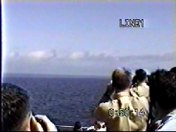
Systems, Models and Views
• Model – abstraction describing a system or a subsystem
• View – depicts selected aspects of a model
Notation – set of graphical or textual rules for depicting models and views:
formal notations, “napkin designs”
System: Airplane
Models:
Flight simulator
Scale model
Views:
Blueprint of the airplane components
Electrical wiring diagram, Fuel system
Sound wave created by airplane
Notes:
SOURCES FOR F14 Flyby sources on You-Tube:
Sonic Boom - Extreme Close Fly By: http://www.youtube.com/watch?v=QX04ySm4TTk
Awesome SONIC BOOM: http://www.youtube.com/watch?v=jZ3Hhdr8EjI
A view is a subset of a model that makes it more understandable
Alle the blueprints needed to build a scale model are a view of the scale model.
The film shows a flyby of a F-14 airplane at an aircraft carrier reaching supersonic speed. The sound wave can be well seen.

Slide 5
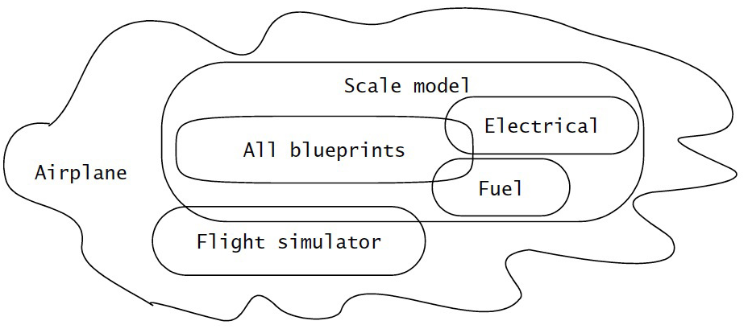
Systems, Models and Views
(“Napkin” Notation)
Views and models of a complex system usually overlap
Notes:
This is a graphical notation of a system.
We show the systems and subsystems as areas, and annotate them with clouds containing the name of the system.
It is important to notice that we use this type of notation in many situations, we might write it down in the sand on the beach, we might use a napkin in a restaurant.
It is a conceptual description of the system, using a freeformat notation.
For this reason I call it the napkin notation

Slide 6
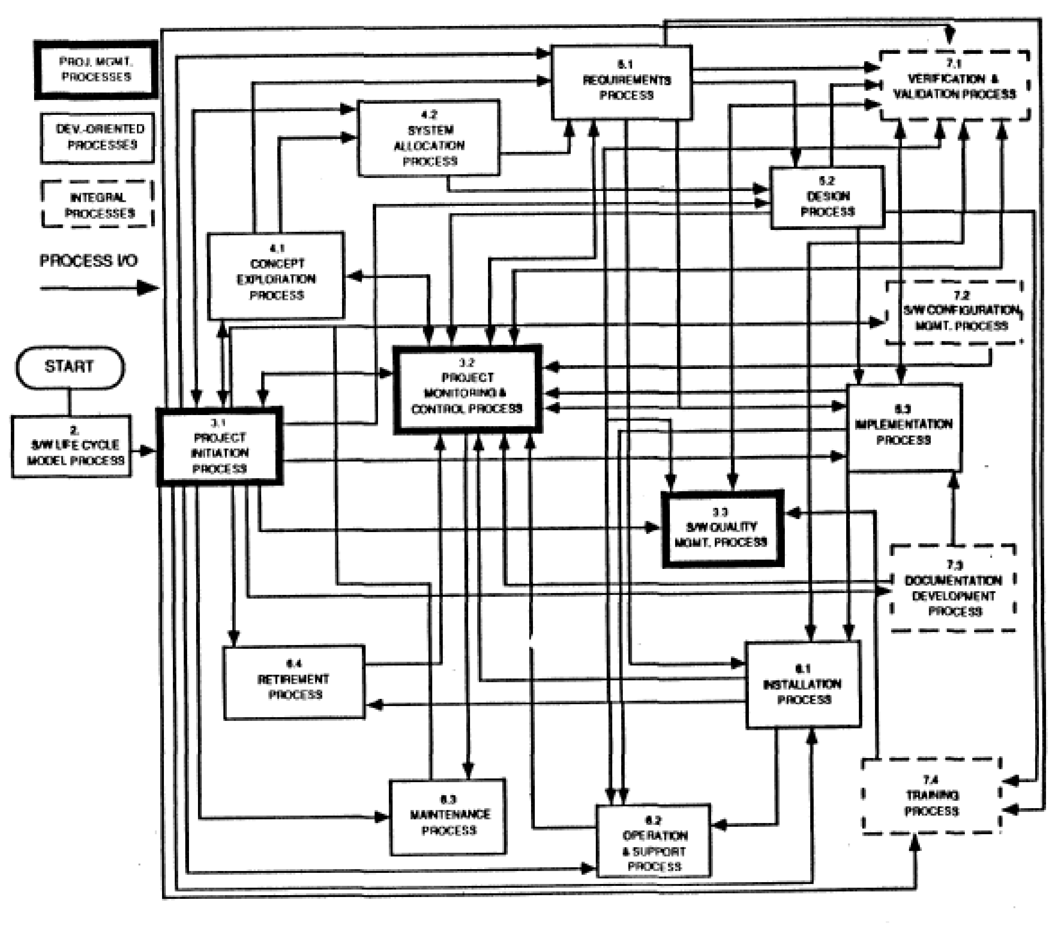
What is the problem with this Drawing?

Slide 7
Abstraction
Complex systems are hard to understand
The 7 +- 2 phenomena
Our short term memory cannot store more than 7+-2 pieces at the same time -> limitation of the brain
My Phone Number: 498928918204
Notes:
Inherent human limitation to deal with complexity
In philosophical terminology, abstraction is
Definition (Wikipedia): An abstraction is an idea, concept, or word which defines the phenomena
which make up the concrete events or things which the abstraction refers to
A model is a construct that represents physical, biological or social systems, with a set of variables and a set of logical and quantitative relationships between them.
Models are constructed to enable reasoning within a idealized logical framework about these systems and are an important component of scientific theories.
Idealized here means that the model may make explicit assumptions that are known to be false in some detail, but by their simplification of the model allow the production of acceptably accurate solutions.
(Animation) This is a scale model of a real train.
A scale model is a replica or prototype of an object built either for research or as a hobby,
usually built smaller than the existing or intended thing, though can equally be built larger to illustrate
something that would otherwise be hard to see.

Slide 8
Abstraction
Complex systems are hard to understand
The 7 +- 2 phenomena
Our short term memory cannot store more than 7+-2 pieces at the same time -> limitation of the brain
My Phone Number: 498928918204
Chunking:
Group collection of objects to reduce complexity
4 chunks:
State-code, Area-code, Local-Prefix, Internal-Nr
Notes:
Inherent human limitation to deal with complexity
In philosophical terminology, abstraction the process in concept-formation of recognizing some set of common features in individuals.
Definition (Wikipedia): An abstraction is an idea, concept, or word which defines the phenomena which make up the concrete events or things which the abstraction refers to
A model is a construct that represents physical, biological or social systems, with a set of variables and a set of logical and quantitative relationships between them.
Models are constructed to enable reasoning within a idealized logical framework about these systems and are an important component of scientific theories.
Idealized here means that the model may make explicit assumptions that are known to be false in some detail, but by their simplification of the model allow the production of acceptably accurate solutions.

Slide 9
Abstraction
Complex systems are hard to understand
The 7 +- 2 phenomena
Our short term memory cannot store more than 7+-2 pieces at the same time -> limitation of the brain
My Phone Number: 498928918204
Chunking:
Group collection of objects to reduce complexity
State-code, Area-code, Local Prefix, Internal-Nr
Phone Number
Country-Code
Area-Code
Local-Prefix
Internal-Nr

Slide 10
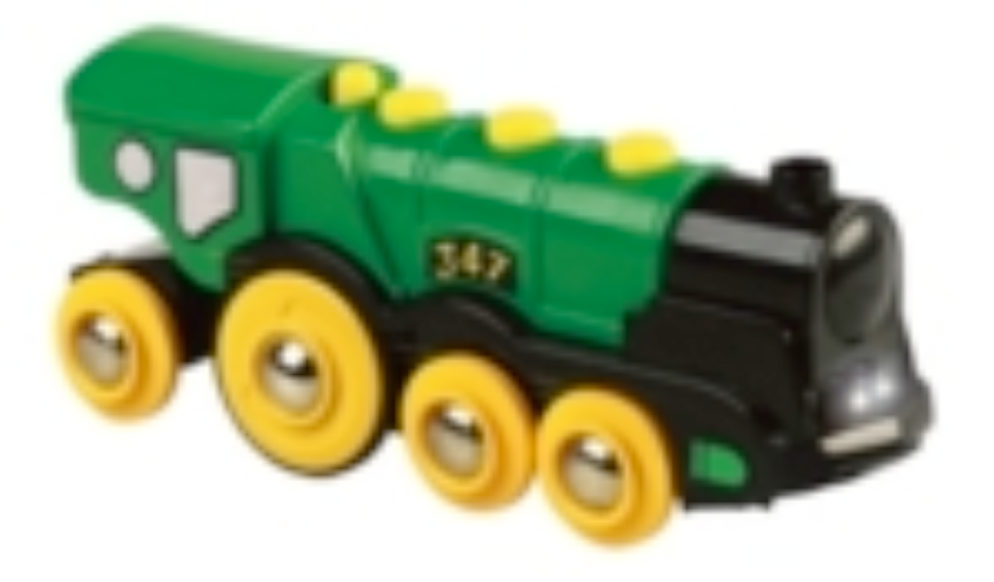
Abstraction
Abstraction allows us to ignore unessential details
Two definitions for abstraction:
Abstraction is a thought process where ideas are distanced from objects
Abstraction as activity
Abstraction is the resulting idea of a thought process where an idea has been distanced from an object
Abstraction as entity
Ideas can be expressed by models
Notes:
(Animation) This is a scale model of a real train.
A scale model is a replica or prototype of an object built either for research or as a hobby,
usually built smaller than the existing or intended thing, though can equally be built larger to illustrate
something that would otherwise be hard to see.

Slide 11
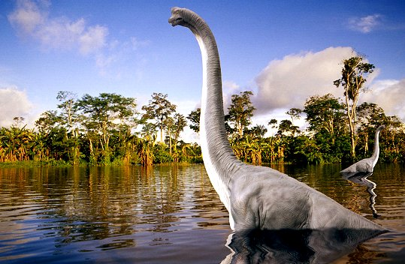
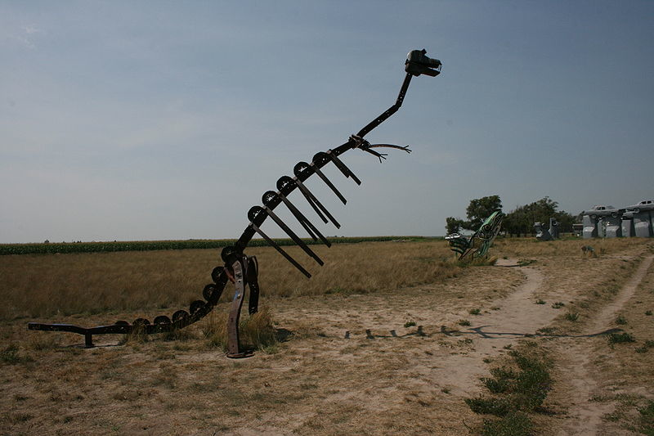
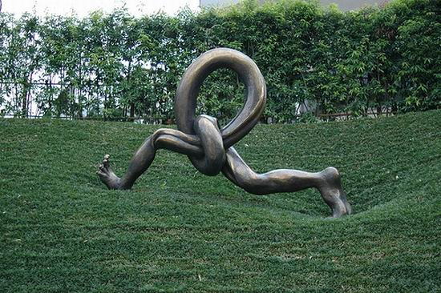
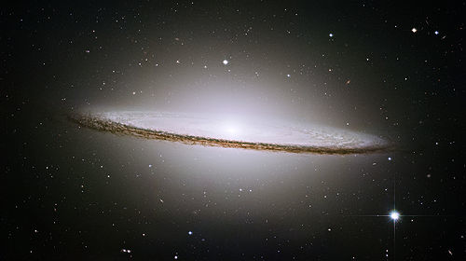
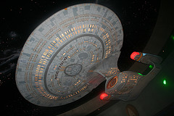
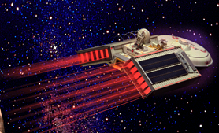
Models
A model is an abstraction of a system
System that no longer exists
Existing system
Future system to be built
Notes:
Acknowledgements:
Dinosaur: http://upload.wikimedia.org/wikipedia/commons/1/12/Carhenge_dinosaur.jpg
Sombrero galaxy: http://www.spacetelescope.org/images/html/opo0328a.html (direct link)
Star trek enterprise 1701: Picture from http://www.flickr.com/photos/sneezypb/2688690679/ (Creative Common License: http://creativecommons.org/licenses/by-sa/2.0/deed.en)
If you reuse these pictures in your class lectures, please make sure to read the wiki commons license: http://commons.wikimedia.org/wiki/Commons:Welcome
Many methods that have been successfully applied in the natural sciences and humanities can be applied to the sciences of the artificial as well.
By looking at the other sciences, we can learn quite a bit. One of the basic methods of science is modeling.
A model is an abstract representation of a system that enables us to answer questions about the system.
Models are useful when dealing with systems that are too large, too small, too complicated, or too expensive to experience firsthand.
Models also allow us to visualize and understand systems that either no longer exist or that are only claimed to exist.
Fossil biologists unearth a few bones and teeth preserved from some dinosaur that no one has ever seen. From the bone fragments, they reconstruct a model of the animal, following rules of anatomy. The more bones they find, the clearer their idea of how the pieces fit together and the higher the confidence that their model matches the original dinosaur. If they find a sufficient number of bones, teeth, and claws, they can almost be sure that their model reflects reality accurately, and they can guess the missing parts. Legs, for example, usually come in pairs. If the left leg is found, but the right leg is missing, the fossil biologists have a fairly good idea what the missing leg should look like and where it fits in the model. This is an example of a model of a system that no longer exists
Today’s high-energy physicists are in a similar position to that of a fossil biologist who has found most of the bones. Physicists are building a model of matter and energy and how they fit together at the most basic subatomic level. Many years of experiments with particle accelerators have given high-energy physicists enough confidence that their models reflect reality and that the remaining pieces that are not yet found will fit into the so-called standard model. This is an example of a model for a system that is claimed to exist.

Slide 12
We use Models to describe Software Systems
Object model: What is the structure of the system?
Functional model: What are the functions of the system?
Dynamic model: How does the system react to external events?
System Model: Object model + functional model + dynamic model
Notes:
Object model: What is the structure of the system? What are the objects and how are they related?
Functional model: What are the functions of the system? How is data flowing through the system?
Dynamic model: How does the system react to external events? How is the event flow in the system ?

Slide 13
Other models used to describe Software System Development
Task Model
PERT Chart: What are the dependencies between tasks?
Schedule: How can this be done within the time limit?
Organization Chart: What are the roles in the project?
Issues Model
What are the open and closed issues?
What blocks me from continuing?
What constraints were imposed by the client?
What resolutions were made?
These lead to action items
Notes:
Object model: What is the structure of the system? What are the objects and how are they related?
Functional model: What are the functions of the system? How is data flowing through the system?
Dynamic model: How does the system react to external events? How is the event flow in the system ?

Slide 14
Issue-Modeling
Issue:
What is the
Center of the
Universe?
Proposal1:
The earth!
Proposal2:
The sun!
Pro:
Aristotle
says so.
Pro:
Copernicus
says so.
Con:
Jupiter’s moons rotate
around Jupiter, not
around Earth.
Pro:
Change will disturb
the people.

Slide 15
Issue-Modeling
Issue:
What is the
Center of the
Universe?
Resolution (1615):
The church
decides proposal 1
is right
Proposal1:
The earth!
Proposal2:
The sun!
Pro:
Aristotle
says so.
Pro:
Copernicus
says so.
Con:
Jupiter’s moons rotate
around Jupiter, not
around Earth.
Pro:
Change will disturb
the people.

Slide 16
Issue-Modeling
Issue:
What is the
Center of the
Universe?
Resolution (1998):
The church declares
proposal 1 was wrong
Resolution (1615):
The church
decides proposal 1
is right
Proposal1:
The earth!
Proposal3:
Neither!
Proposal2:
The sun!
Pro:
Aristotle
says so.
Pro:
Copernicus
says so.
Con:
Jupiter’s moons rotate
around Jupiter, not
around Earth.
Pro:
Change will disturb
the people.
Pro:
Galaxies are moving away
From each other.

Slide 17
2. Technique to deal with Complexity: Decomposition
A technique used to master complexity (“divide and conquer”)
Two major types of decomposition
Functional decomposition
Object-oriented decomposition
Functional decomposition
The system is decomposed into modules
Each module is a major function in the application domain
Modules can be decomposed into smaller modules
Notes:
Which decomposition is the right one? If you think you are politically correct, you probably want to answer: Object-oriented. But that is actually wrong. Both views are important
Functional decomposition emphasises the ordering of operations, very useful at requirements engineering stage and high level description of the system.
Object-oriented decomposition emphasizes the agents that cause the operations. Very useful after initial functional description. Helps to deal with change (usually object don’t change often, but the functions attached to them do).

Slide 18
Decomposition (cont’d)
Object-oriented decomposition
System is decomposed into classes (“objects”)
Each class is a major entity in the application domain
Classes can be decomposed into smaller classes
Object-oriented vs. functional decomposition
Which decomposition is the right one?
Notes:
Which decomposition is the right one? If you think you are politically correct, you probably want to answer: Object-oriented. But that is actually wrong. Both views are important
Functional decomposition emphasises the ordering of operations, very useful at requirements engineering stage and high level description of the system.
Object-oriented decomposition emphasizes the agents that cause the operations. Very useful after initial functional description. Helps to deal with change (usually object don’t change often, but the functions attached to them do).

Slide 19
Functional Decomposition
System
Function
Top Level functions
Read Input
Transform
Produce
Output
Level 1 functions
Read Input
Transform
Produce
Output
Level 2 functions
Load R10
Add R1, R10
Machine instructions

Slide 20
Functional Decomposition
Functionality is spread all over the system
Maintainer must understand the whole system to make a single change to the system
Consequence
Source code is hard to understand
Source code is complex and impossible to maintain
User interface is often awkward and non-intuitive

Slide 21
Functional Decomposition
Functionality is spread all over the system
Maintainer must understand the whole system to make a single change to the system
Consequence:
Source code is hard to understand
Source code is complex and impossible to maintain
User interface is often awkward and non-intuitive
Example: Microsoft Powerpoint’s Autoshapes
How do I change a square into a circle?
?

Slide 22
Changing a Square into a Circle
First Attempt:
Check the Format Menu: Autoshape
?

Slide 23
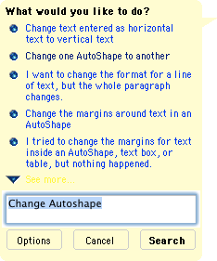
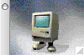
Second Attempt: Ask the Help Assistant
Change one AutoShape to another:
1. Select the AutoShape you want to change.
2. On the Drawing toolbar, click Draw , click Change AutoShape, point to a category, and then click the shape you want.

Slide 24
Functional Decomposition: Autoshape
Autoshape
Change
Draw
Change
Rectangle
Change
Oval
Change
Circle
Draw
Rectangle
Draw
Oval
Draw
Circle

Slide 25
Object-Oriented View
Autoshape
Draw()
Change()

Slide 26

What is This?
An Eskimo!
Cave
Ellbow
Neck
Glove
Pocket
Coat

Slide 27
A Face!
Hair
Eye
Nose
Ear
Mouth
Chin

Slide 28
An Eskimo!
A Face!
Cave
Hair
Neck
Eye
Ellbow
Nose
Ear
Glove
Pocket
Mouth
Coat
Chin

Slide 29
Where are we?
Three ways to deal with complexity
Abstraction, Decomposition, Hierarchy
Object-oriented decomposition is good
Unfortunately, depending on the purpose of the system, different objects can be found
How can we do it right?
Start with a description of the functionality of a system
Then proceed to a description of its structure
Ordering of development activities
Software lifecycle
Notes:
The identification of objects and the definition of the system boundary are heavily intertwined with each other.
That is, we are ordering the development activities in a certain way

Slide 30
Models must be falsifiable
Karl Popper (“Objective Knowledge):
There is no absolute truth when trying to understand reality
One can only build theories, that are “true” until somebody finds a counter example
Falsification: Act of disproving a theory or hypothesis
Truth of a theory is never certain. We use phrases like:
“by our best judgement”, “using state-of-the-art knowledge”
In software engineering any model is a theory
We build models and try to find counter examples by:
requirements validation, user interface testing, review of the design, source code testing, system testing, etc.
Testing: Act of disproving a model

Slide 31
UML Models
Structure models
static view of the system
models data requirements and operations on data
operations obtain from behavioral model
class diagram
Behavior models
operational view of the system
models function requirements
diagrams
use case
activity
communication
State change models
dynamic view of the system
models object evolution over time
state machine diagram

Slide 32

1. The use case view
the focal point of behavior modeling
presents the dynamic view of the system
it models function requirements
represents business transactions, operations, and algorithms on data
The hardest single part of building a software system is deciding precisely what to build.
– Frederick Brooks, The Mythical Man-Month

Slide 33
Use Case Modelling
Models and documents the functional requirements of a problem domain
Results in the production of the
functional requirements
which are the detailed, role based, functional account of the requirements
Notes:
47

Slide 34
Background
Use cases were first described by Ivar Jacobson
Object-Oriented Software Engineering: A Use Case-Driven Approach. Addison Wesley, 1992.
Subsequently incorporated into numerous other OO methods
e.g. RUP, Process MeNtOR, RWSP, RDD, Booch, …
Forms the basic technique for capturing user requirements
Notes:
49

Slide 35
Why Use Cases?
Formalises users’ expectations of what the system is to do and how the system is to be used
Easy technique to understand
documents actual paths through the system
User-driven process
encourages user involvement
Basis for scoping and prioritising development work
Basis for acceptance testing
Well aligned with Business Process Re-engineering
Notes:
50

Slide 36
Actors, Use Cases & Association
Actors are the things outside of the system that interact with the system
users, other systems, …
Use Cases are features of the system that an actor uses
Associations indicates there is a relationship between an actor and a use case
Actor
Association
Use Case

Slide 37
Actors
Anything that interacts with the system
people as well as other systems
important in defining the boundary of the system
Not described in detail
they’re outside of system
though their interface is usually defined
Normally act in several use cases
Represents a role that a user can play
many users are represented by a single actor
one user can be different actors at different times
performs different use cases depending on role
Notes:
53
68
An Actor differs from a user. A user is a human that uses the system, whereas an Actor represents the specific role a user can play. For example, John Smith is a user but he may play the role of a Account Manager or Customer Service Operator at different time. These would be two separate actors.
A starting point for finding Actors is to ask:
∑ "Who are the people that this system is supposed to help?"
∑ "What systems interact with this system?"
∑ "What systems are used by this system?"
Note that time can be viewed as an Actor as it can trigger certain activities. Under this circumstance, the Actor may be represented as a ìclock and calendar".

Slide 38
Actors and Users
Distinguish between actors and users
A user plays the role of an actor
an example of an actor is a “clerk”
an example of a user is “John Smith”
an actual clerk
A particular user may play the roles of many different actors
an example of a user may be “Sarah Jones” who sometimes plays the role of a “developer” and at other times the role of “system administrator”
“Developer” and “System Administrator” are actors
Notes:
54

Slide 39
Actors
are External to System
uc Hospital Admin
Update Chart
Nurse
Patient
Admit Patient
Admissions
Clerk
Make sure that actors are people or other systems that would actually use the system
not things that would be modelled within the system
e.g. in a hospital administration system, patients would be modelled within the system, but are unlikely to use the system themselves

Slide 40
Actors
are External to the System
uc Hospital Admin
Update Chart
Nurse
Admin
System
Admit Patient
Admissions
Clerk
The system does not use itself
Use cases describe what the system does

Slide 41
Actors
are Not Technical Choices
uc Hospital Admin
Update Chart
Nurse
DBMS
Admit Patient
Admissions
Clerk
DBMS is a particular storage strategy
design decision
should not appear in the requirements

Slide 42
Actors
Interact with the System
uc Hospital Admin
Update Chart
Nurse
Admit Patient
Admissions
Clerk
Actors interact with the system
use it to perform a task
provide a service used by the system
secondary actors

Slide 43
Primary and Secondary Actors
Primary actors are those actors that the system is designed to serve
main users of the system
represent the users for whom the system is designed
focus for modelling the system
Secondary actors are support roles
secondary actors only exist so that primary actors can use the system
Notes:
55

Slide 44
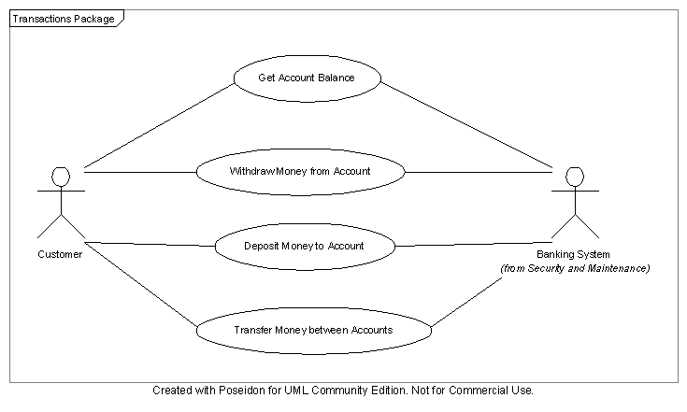
Primary and Secondary Actors

Slide 45
Actors – Naming Guidelines
Use a noun for an actor name
Begin each word in the name with a capital letter
e.g. BankingSystem

Slide 46
What is a Use Case?
A way to use the system
“A sequence of transactions offered by the system that yield a useful result for an actor.” [Jacobson et al, 1992]
Describes externally required functionality
Describes what a system does
but not how it does it
Specify the behaviour of a use case by describing a flow of events in text

Slide 47
Use Cases – Naming Guidelines
Use a verb phrase not a noun phrase
use cases describe an activity
Name from the primary actor’s perspective
e.g. Withdraw Money

Slide 48
Use Case Modelling Tasks
1. Identify Actors
<<include>>
2. Identify Initial Use Cases
4. Identify Packages
3. Produce Use Case Diagram
5. Develop Initial Use Cases
6. Refine Use Cases
Requirements
Modeller
<<include>>
<<include>>
7. Restructure Use Cases
User Interface Modelling/Prototyping
8. UI Modelling and/or Prototyping
Notes:
61

Slide 49
Task 1: Identify Actors
Identifying actors is the starting point for use case analysis
“Who is this system supposed to help?”
Finding human actors is relatively straight forward
Actors that are other systems are sometimes less obvious
Don’t assume that current users will be actors in the system
think about potential users i.e. how can the current system be improved
May wish to record current system actors to help think about potential actors
Notes:
62

Slide 50
Examples of Actors – ATM
ATM
Customer
Bank System
Bank Staff
Notes:
63

Slide 51
Actor Description Template
Actor Name
Description | A description of the role this actor plays.
Aliases | Other names that may be used in the problem domain to describe this actor.
Inherits | The name of any other actor from which behaviour is inherited
Protocol | Only included if this actor represents an external device or system. Receives: Messages that this actor receives from the system. Sends: Messages that this actor sends to the system.
© Richard Thomas, 1992–2018
51

Slide 52
Example Actor Description
Actor Name: Customer
Description: Uses the ATM to conduct bank transactions.
Alias: User
Inherits: none
Contact: Jane Simmonds
Contact Details: 3333 1234
Actor Name: Bank System
Description: External system used to verify customers and transactions.
Alias: none
Inherits: none
Protocol: Receives: Validate PIN, Transaction Request … …
Sends: PIN Validation Result, Transaction Approval … …
Contact: Michael Clarke
Contact Details: 3333 5678
Notes:
65

Slide 53
External Systems as Actors
If an entity interacts with a domain, then it is considered to be an actor
An actor that is another system or device is considered to be an External System Actor
ATM
Withdraw
Funds
<<actor>>
BankSystem
Customer
An External
System Actor Example
Notes:
66
72
The separation of Actors and External Systems is often required when the requirements of a client/server environment are being explored. Consider the case study. Letís assume that the Mail Users wish to be able to receive mail posted from outside the organisation. The external mail items may be retrieved periodically from the an External Mail Service. To represent this on a Business Scenario Model, we may identify the External Mail Service as an external system and a Clock and Calendar Actor who periodically initiates (through a scenario) a request to receive external mail from the external mail service.

Slide 54
Task 2: Identify Initial Use Cases
For each actor note the activities/tasks they do as part of their role
Each activity/task should be listed as a verb phrase
Examine the tasks, or potential tasks, of each actor in turn
an initial use case can be identified from each activity/task
Notes:
68
74
Given that Actors perform business scenarios, by examining each Actor in turn and identifying ways in which they interact with the domain (the different scenarios that the Actor performs), it is possible to define the required functionality of the business domain(s).

Slide 55
Task 2: Identify Initial Use Cases (cont.)
To identify use cases read the specifications from each actor’s perspective
Interview business users as to what they wish the system to do and how they wish to interact with the new system
Where an activity is common to a group of actors, it’s possible to identify an abstract actor to deal with the interaction
Notes:
69

Slide 56
Sources of Use Cases
Possible sources for use cases (to name a few)
functional requirements specifications
domain material
interviews with users
personal experience
workshops with users
Identify the logical functioning of the business process; do not include technical details
state “what” is required and “why”
not “how”
Notes:
70
75
A useful question to ask of a business scenario is "Are there two ways to implement this scenario?" and try to think of both a manual and an automated way. This will force the scenario to be written in a non application/technology manner.

Slide 57
Tips for Identifying Use Cases
The following questions are useful starting points
What are the main tasks of each actor?
Will the actor have to read/write/change any of the system information?
Will the actor have to inform the system about outside changes?
Does the actor wish to be informed about unexpected changes?
Notes:
71

Slide 58
Appropriate Size
How big?
Where does it start?
When does it end?
How much detail?

Slide 59
Size: Completable Useful Task
Either 100% complete or 0% complete
Named after a goal
Verb Phrase (e.g. Schedule Flight)
Six to ten steps
One actor, one place, one time

Slide 62
Example Use Cases
Connect to ATM
Customer connects to ATM
Withdraw Funds
Customer withdraws funds from ATM
Deposit Funds
Customer deposits funds into ATM
Close ATM
Bank Staff closes ATM
Open ATM
Bank Staff opens ATM
Notes:
72

Slide 63
Task 3: Draw Use Case Diagram
Once the actors and their use cases have been identified a use case diagram can be drawn
Use case is a high-level overview of system
actors
use cases
boundary of system
Most useful for presentation and communication purposes
Notes:
76

Slide 64
Task 3: Draw Use Case Diagram (cont.)
High-level overview of system requirements
Connect to
ATM
Withdraw
Funds
Deposit
Funds
Customer
Transfer
Funds
Notes:
77
80
Actors are shown to interact with the scenarios of a domain using the two headed arrow. Within a domain, scenarios may be related to each other through a uses or extends relationship. This type of relationship is shown on the graphical scenario diagram using a single headed arrow (see Task 7: Restructure the scenarios for a discussion of the uses and extends relationships).

Slide 65
Mis-Use Cases
Associations in use case diagrams connect actors to use cases
never actors to actors, or use cases to use cases
Most importantly, they’re not designed to show a functional decomposition of the system
following diagram is not a valid use case diagram
boil water
make coffee
add coffee
coffee
drinker
pour coffee

Slide 66
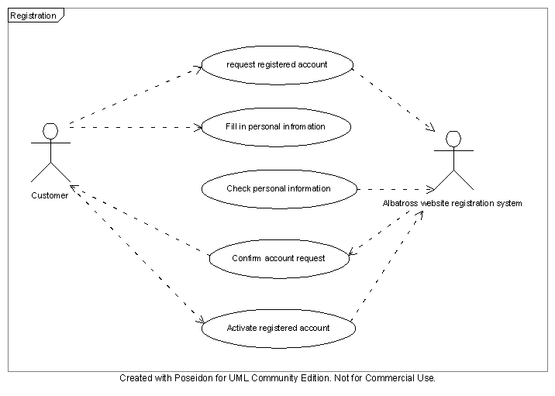
Use Cases
are Not a Flowchart
“A sequence of transactions offered by the system that yield a useful result for an actor.” – Jacobson et al, 1992
Notes:
6

Slide 67
Task 4: Identify Packages
Useful to group use cases into packages that represent subject areas
logical aspect of the problem space where a group of use cases work towards a common goal
Notes:
78
81
When the requirements of a large problem are analysed using the Requirements Modelling process, they will often cover several subject areas.

Slide 68
Packages – UML Notation
Automated Teller Machine
Customer Interaction
ATM Maintenance
Connect to
ATM
Open ATM
Withdraw
Funds
Close ATM
Deposit
Funds
Process
End Of Day
Bank Staff
Customer
Transfer
Funds
Notes:
79
101
This illustrates a possible graphical scenario diagram that identifies five subject areas within a manufacturing domain (Production Planning, Inventory, Production Scheduling, Process Control and Production Process). In addition, a textual account of each Actor, scenario and subject areas would be recorded as part of the Scenario Model.
If the project is exploring a domain that exists within a work programme, the project responsibilities will already be defined in terms of subject areas. These subject areas are identified within the Programme Requirements Model. The Business Scenario Model must therefore work within the bounds of these subject areas. It is possible for a project to refine the programme level definition of the subject areas, and identify subject areas that exist inside the bounds of the scoping subject areas.

Slide 69
Task 5: Develop Initial Use Cases
Develop in workshop/JAD sessions in conjunction with client representatives
Requirements Modeller acts as a facilitator
Prototype Developer may be observer
Initially keep use cases simple and abstract
describe basic idea of what needs to be done
too much detail makes use cases difficult to change
Use Cases may vary considerably at this stage as ideas are brainstormed
Notes:
83

Slide 70
Breadth-First Development
We are too eager for detail
It’s a process of discovery
Early detail leads to wasted effort
requirements “churn”
prolonged requirements phase
loss of patience

Slide 71
Prioritise the Use Cases
Complete listing of use cases should be prioritised based on organisational needs
Allows important functions to be delivered first and the system roll-out to be business requirements driven
focus on ROI
Notes:
84

Slide 72
Identify Typical and Alternative Scenarios
Use cases are composed of typical and alternative scenarios
Typical scenarios – normal sequence of events
what is intended to happen
Alternative scenarios – abnormal courses of operation
represent errors, or conditions not often encountered
only conditions system can detect
combine conditions with the same result
Focus on understanding the typical scenario first
initially just list the alternatives
Notes:
85

Slide 73
Documenting Use Cases Guidelines
Initially just specify the events of the use case as a series of steps
During refinement ensure that a statement of "why" a step is being executed is included
easy for a domain expert to forget to document why
because it seems obvious
remember the model will be read by people unfamiliar with the domain
Notes:
73
78
Business scenarios are recorded in accordance with the template presented in Book 5.
When the template is used, all sections must be complete. If there is no valid statement for a section (ie. there are no alternative courses at this time), then a statement of none should be recorded.
When the scenario text section is completed, ensure that the text is well structured.

Slide 74
Documenting Use Cases (cont.)
Number the steps
If steps are completed within the context of another step, indent the text and the numbers
1. The First Step
1.1 This step must be completed to accomplish step 1
1.2 This is the next step to accomplish step 1
2. The Second Step

Slide 75
Documenting Use Cases (cont.)
When the typical scenario is being written, identify any alternative scenarios
they do not have to be fully documented until the final release point
Document steps of a use case sequentially
step the actor performs
followed by step the system does in response
next step the actor performs
…
Show what the actor does or gets
Notes:
74

Slide 76

Use Case Template

Slide 77
Withdraw Cash Use Case

Slide 78
Description Detail
Subject to some debate
Previous example and template are based on what I consider best practice
particularly when there is limited interaction between developers and user representatives
extends well-known published methods
e.g. RUP, Thomsen-Dué
Provide enough detail so the Business Owner can verify it performs the actions they require
Functionality of the system needs to be described in enough detail to allow object decomposition

Slide 79
Use Cases and the User Interface
It is best to keep use cases abstract
use cases should describe what the actor logically wants to achieve by using the system
not the means by which they achieve those goals
precise level of abstraction is somewhat arbitrary
UI design is a separate activity
after use cases have been validated

Slide 80
Essential Use Cases
Refines use cases down to the core interactions and user intentions
nothing at all related to the technology
no internal steps of the system are described
UI design is a completely separate and large step
Constantine, L., & L. Lockwood. Software for Use: A Practical Guide to the Models and Methods of Usage-Centered Design. Addison-Wesley, 1999.

Slide 81
Task 6: Refine the Typical and Alternative Scenarios
Once the typical and alternative scenarios have been identified and agreed they need to be refined
Prototyping may be used during the refinement process to model the detailed interaction with the system
Refining use cases involves adding greater detail
may be done through workshops or prototyping
depending upon the complexity of the use case
Notes:
92

Slide 82
Task 6: Refine the Typical and Alternative Scenarios (cont.)
Requires attention to detail
good understanding of problem domain and system goal
Use cases can be developed in parallel
different primary actors by different teams
Use cases can be added to each other to create more complex use cases
Notes:
93

Slide 83
Example Refined Use Case
Connect to ATM – first iteration
Connect to ATM – second iteration
1. Customer identifies themselves to ATM
2.1 ATM successfully identifies Customer
2.2 ATM requests Customer select transaction type
1. Customer inserts card into ATM
3. Customer enters PIN
5. Bank System successfully authorises access
2.1 ATM reads card
2.2 ATM requests customer to enter PIN
4. ATM requests authorisation of card and PIN with Bank System
6. ATM requests Customer select transaction type
Notes:
94

Slide 84
Task 7: Restructure Use Cases
Restructure the use cases to maximise reuse and minimise redundancy
Use cases can be restructured in three ways
«include» relationship
«extend» relationship
generalisation
Functional decomposition
identify repeatedly used or specialised portions and factor them out
Notes:
98
83
The activity is mainly of interest to the development team rather than the business users and may be regarded as a re-engineering function of the requirements.
This task will be executed many times as the scenario model progresses from an initial release to a core release. The scenarios should not require large amounts of restructuring once the core release has been completed.

Slide 85
«include» Relationship
Factor out common behaviour in use cases
sequence of steps appearing in multiple use cases
needs to be more than a couple of steps
avoids inconsistency in requirements
Scenario always uses the included steps
included steps do not have to be a complete use case
i.e. initiated by an actor
Too much factoring
behaviour is scattered across multiple use cases
Notes:
99
84
When an includes relationship is used to restructure a set of scenarios, the construct does not only manifest itself in the form of a graphical scenario model. The business scenarios themselves must also use a set notation to specify when another scenario is being included. This notation comes in the form of a includes: label that is embedded within the scenario text. When the label is encountered within a particular event, the flow of control must pass to the scenario identified until that scenario has been completed. In this way, the includes: construct is similar to a Basic GOSUB.
Decomposing business scenarios to identify abstract business scenarios should not be taken to extreme. Abstract scenarios should remain an interesting sequence of interactions and not just atomic actions.

Slide 86
Illustrating the «include» Relationship
In the original use case the phrase «include» <use case name> is inserted where the included use case begins
Steps of the new use case are removed from the original use case
«include» relationship can be shown in the use case diagram
Use case 1 «include» Use case 2
Use case 1
«include»
Use case 2
UML Notation
Notes:
100

Slide 87
Example
Reply to a message
«include»
Compose a Message
Broadcast a Message
«include»

Slide 88
«include» Relationship in the Scenario Text
Use Case Title: Reply to a Message
Ref. Number: ES002
Summary: Allows the user to reply to a message
Primary Actor: Mail User
Inherits: None
Includes: Compose a Message
Extension Points: None
Preconditions: A message is selected
Typical Sequence of Events:
1. Read Message
2. Create a reply
«include» Compose a Message
3. Send the reply
Use Case Title: Compose a Message
Ref. Number: ES003
Summary: Allows the user to create a message
Primary Actor: Mail User
Inherits: None
Includes: None
Extension Points: None
Preconditions: None
Typical Sequence of Events:
1. Enter message header
2. Enter message body
3. … …
Notes:
101
86
Take note of the uses: Compose a Message label in the scenario text.

Slide 89
«extend» Relationship
Factors out optional behaviour in use cases
when a scenario produces a different result in certain situations
alternate condition affects several steps
> 2 or 3
alternate flow becomes complex
> 3 or 4 steps
Understanding complete behaviour requires reading more than one use case
Notes:
102
87
The extending business scenario describes where it is to be inserted by specifying a location in the original text. The extend section of the business scenario template indicates those business scenarios that are extended by the current one.
When a new business scenario is inserted, the original runs as normal up until the new business scenario location is reached. At this point the new business scenario starts and runs to completion. The added scenario and the original run together as if there had been no interruption.

Slide 90
«extend» Relationship
Extended scenario may be completed without including the steps from the extending use case
removes need to have multiple typical scenarios to capture the optional paths of a use case
Delivery of extending use cases can occur in later phases of development
Notes:
102
87
The extending business scenario describes where it is to be inserted by specifying a location in the original text. The extend section of the business scenario template indicates those business scenarios that are extended by the current one.
When a new business scenario is inserted, the original runs as normal up until the new business scenario location is reached. At this point the new business scenario starts and runs to completion. The added scenario and the original run together as if there had been no interruption.

Slide 91
Extension Point
In the extended use case the phrase (extension point: <extending use case>) is included in the description
indicating point at which the extending use case begins
condition that causes the extension is highlighted
Scenario for the base use case runs as normal until the extension point
Under certain conditions the extending use case then begins and runs to completion
Base use case then resumes
Notes:
103

Slide 92
Illustrating the «extend» Relationship
An extends relationship can be shown in the graphical use case model in two ways
Use case 2 extends Use case 1
Use case 1
Use case 1
extension points
extension point name 1
extension point name 2
«extend»
OR
«extend»
(extension point)
Use case 2
Use case 2
UML Notation
Notes:
105

Slide 93
Examples
Place priority order
«extend»
Place Customer Order
Place promotional offer order
«extend»
Place Customer Order
extension points
promotional offer
priority order
«extend»
(priority order)
Place priority order
Place promotional offer order
«extend»
(promotional offer)
Notes:
106

Slide 94
«extend» Relationship in the Scenario Text
Use Case Title: Place Customer Order
Ref. Number: UC005
Summary: A salesperson selects to place a customer order
Primary Actor: Salesperson
Inherits: None
Includes: None
Extension Points: Promotional Offer, Priority Order
Typical Sequence of Events:
1. The Salesperson selects to place an order
3. The Salesperson completes the order form by:
3.1 entering the Customer details
3.2 entering the products and quantities ordered
(extension point: promotional offer)
3.3 entering the delivery method
(extension point: priority order)
5. … … …
Use Case Title: Promotional Offer
Ref. Number: UC008
Summary: If the item is part of a promotional offer then a discount is calculated for the item
Primary Actor: Salesperson
Inherits: None
Includes: None
Extension Points: None
Typical Sequence of Events:
1.1 The system calculates the discount applicable to the item
1.2 The system displays the discount applied on the order form

Slide 95
Use Case Generalisation
General behaviour can be factored out using generalisation
like inheritance in class design
Use when the behaviour of the child use case is more specific than that described by the parent use case
general – specialised relationship

Slide 96
Illustrating Use Case Generalisation
In the specialised use case the phrase inherits: <parent use case> is included in the text
The scenario text of the child indicates the behaviour of the parent that is replaced or refined
refine <step number in general use case>
replace <step number in general use case>
Generalisation relationship can be shown in the use case diagram
Use case 2 inherits Use case 1
Use case 1
Use case 2
UML Notation

Slide 97
Example
Sell
Insurance Policy
Sell Contents Insurance
Sell Boat
Insurance
Sell Motor Vehicle Insurance

Slide 98
Generalisation in the Scenario Text
Use Case Title: Sell Insurance Policy
Ref. Number: UC025
Summary: A Customer Service Officer sells a new insurance policy
Primary Actor: CSO
Inherits: None
Extension Points: None
Includes: None
Typical Sequence of Events:
1. The CSO selects to issue a new policy
3. The CSO completes the policy form by
3.1 entering the Customer details
3.2 entering the Address details
5. The CSO selects the type of insurance policy to create
7. The CSO enters the specific information required for the type of policy (refer to child use cases for specifics)
The system calculates the premium payable
… … …
Use Case Title: Sell Contents Insurance
Ref. Number: UC026
Summary: A Customer Service officer sells a new Contents Insurance Policy
Primary Actor: CSO
Inherits: Sell Insurance Policy
Extension Points: None
Includes: None
Typical Sequence of Events:
Replace Step 7 in “Sell Insurance Policy”
7.1 The CSO enters the details of the contents to be covered by the new Policy
7.2 The CSO enters any specified items to be covered by the new Policy
7.3 The CSO enters any items to be excluded from the Policy
… …

Slide 99
General (Abstract) Actors
Actors that share use cases could be abstracted such that a new general actor is created
Don’t go overboard
Ensure the general and specialised actors both represent useful concepts or users
View Pay
Employee
Update Pay
HR Staff
Notes:
107
91
In addition, abstract actor relationship should be documented in the Actor and External System Listing under the inherits category.
If a Scenario Model has many abstracted actors, the actors may be listed in an Actor Inheritance Hierarchy. This hierarchy should include all actors and be attached to the Actor and External System Listing.

Slide 100
Use Case Alternatives
Process or target domain dependent
UX Focus or COTS
Archetypes – behavioural perspective
Personas and Storylines
Agile or Lean
User Stories – informal
Behaviour Driven Development (BDD)
Domain-Specific Language (DSL) for formalism
Real-Time or Embedded
Event – Response Tables
Notes:
Remind students about Eban Escott and Working Mouse using DSLs in MDE.

Slide 101
Event – Response Table
Event | System State | Response
Road Sensor detects vehicle entering left-turn lane. | Left-turn signal is red. Cross-traffic signal is green. | Start green to amber countdown timer for cross-traffic signal.
Green to amber count-down timer reaches zero. | Cross-traffic signal is green. | Turn cross-traffic signal amber. Start amber-to-red countdown timer.
Amber-to-red countdown timer reaches zero. | Cross-traffic signal is amber. | Turn cross-traffic signal red. Wait 1 second. Turn left-turn signal green. Start left-turn-signal countdown timer.

Slide 102
Use Cases vs. User Stories
Both are user-centred
what is to be accomplished
Difference is in granularity
User Stories
Use Cases
statement of user needs
details discovered during development
fleshed out by acceptance tests
description of interaction with system
allows
analysis
verification
validation
more detailed planning

Slide 103
Use Cases Limitations
Interaction focus
usage scenarios
Not suitable
batch processing
e.g. interest calculation
complex business rules
e.g. airfare calculation
computationally intensive
e.g. environmental monitoring & analysis
http://www.oceannetworks.ca/
real-time systems
e.g. railway signalling
embedded systems
e.g. air condition control for a building

Slide 104
Review Quiz 3.1
What are the most important UML behavioral modelling techniques?
Is the use case diagram the same as the use case specification?
Notes:
Use case diagram, sequence diagram, communication diagram, and activity diagram.
No, the use case specification contains the diagram and a complete textual description of the use case intended behavior.

Slide 105
2. The activity view
represents a behavior that is composed of individual elements
the behavior may be a specification of a use case
it may also be a piece of functionality that can be reused in many places

Slide 106

Activity Diagram
Models dynamic behaviour
process workflows
use case scenarios
operations
Steps involved in performing a task
like an algorithm
Notes:
58
48

Slide 107
Activity Diagrams & Use Cases
Model flow of control in scenarios
all scenarios can be shown on one diagram, if required
Flow-chart like representation of a use case
can be useful for workshop reviews of scenarios

Slide 108
Activity Diagrams & BPM
Model activities carried out by actors in business domain
Can establish the business context
before use cases are extracted from the processes
Illustrates interactions between actors in a process
using partitions (swimlanes)

Slide 109
Activities
Select Transaction
Simple Action
lowest level of detail shown in diagram
Invoke Activity
includes a number of steps shown in another diagram
Time Event
triggered by some time related condition
e.g. date, time, period (e.g. n days since)
Process Order
End of
Financial
Year

Slide 110
Nodes
Initial Node – one per diagram
Final Node – optional & more than one allowed
all flows stop when reached
Flow Final Node – flow stops, others continue
Decision Node – one in, multiple out
Merge Node – multiple in, one out

Slide 111
Parallel Flows
Can have concurrent process flows
Fork Node – start concurrent flows
Join Node – joins concurrent flows

Slide 112
User
Interface
Card
Transaction
Card
Reader
Withdrawal
Ask for Transaction
Identify User
Select
Transaction
Ask for
Amount
Perform
Withdrawal
Validate
Amount
Balance too Low
[balance too low]
[ok]
Debit Account
Eject
Card
Cash Not Available
[ATM no cash]
...
Print Receipt
Release Cash

Slide 113
Identify User
Ask for
PIN
[valid card]
Validate
Card
Receive
Card
Validate
PIN
[invalid card]
Wrong
PIN Msg
[invalid PIN & < 3 attempts]
[valid PIN]
Invalid Card Msg
Eject
Card
[too many attempts]
User Identified
Too Many
Attempts Msg
Keep
Card

Slide 114
Activity Diagrams in Use Case Modelling
Determine triggering event that starts use case flow
Identify actions and determine control flow
Add guard conditions and decision points
Add forking and joining to show parallel activity
Create invoke activities if complexity requires it
Group activities into partitions if needed
Add flows corresponding to alternative scenarios
Each path should correspond to an individual scenario

Slide 115
Finding actions in use case flows
No. | Use case statement | Action
1 | The Employee requests the system to display the rental charge together with basic customer and video details. | Display transaction details
2 | If the Customer offers cash payment, the Employee handles the cash, confirms to the system that the payment has been received and asks the system to record the payment as made. | Key in cash amount; Confirm transaction
3 | If the Customer offers debit/credit card payment, the Employee swipes the card and then requests the Customer to type the card’s PIN number, select debit or credit account, and transmit the payment. Once the payment has been confirmed electronically by the card provider, the system records the payment as made. | Swipe the card; Accept card number; Select card account; Confirm transaction

Slide 116
Actions
The Customer’s card does not swipe properly through the scanner. After three unsuccessful attempts, the Employee enters the card number manually.

Slide 117
Activity Diagram – excerpt
Display transaction
details
Cash or card?
cash
card
Handle card payment
Sufficient cash?
Swipe the card
No, use card
Swipe the card
Yes
Swipes OK?
Enter card number
Enter card number
No
manually
No
manually
Yes
Accept card
Accept card
Select card
Key in cash
Select card
number
number
account
account
amount

Slide 118
Review Quiz 3.2
Can an activity model be used as a specification of a use case?
Flows in an activity diagram connect actions and other diagram nodes. What are these other nodes?
Notes:
Yes, it can. Activity modeling can be done at various abstraction levels, including for the internal specification of a use case steps of computation.
Decisions, forks, joins, merges, and object nodes.

Slide 119
3. The structure view
it represents data structures and their relationships
it identifies operations that act on these data

Slide 120
Concepts and Phenomena
Phenomenon
An object in the world of a domain as you perceive it
Examples: This lecture at 9:35, my gold watch
Concept
Describes the common properties of phenomena
Example: All lectures on software engineering
Example: All black watches
A Concept is a 3-tuple
Name: Distinguishes the concept from other concepts
Purpose: Properties that determine if a phenomenon is a member of a concept
Members: Set of phenomena which are part of the concept

Slide 121
Concepts, Phenomena, Abstraction and Modeling
Name
Purpose
Members
Watch
A device that
measures time.
Abstraction
Classification of phenomena into concepts
Modelling
Development of abstractions to answer specific questions about a set of phenomena while ignoring irrelevant details
Notes:
Hourglass

Slide 122
Abstract Data Types & Classes
Superclass
State
Abstract data type
A type whose implementation is hidden from the rest of the system
Class:
An abstraction in the context of object-oriented languages
A class encapsulates state and behavior
Example: Watch
Watch
time
date
SetDate(d)
Behavior
Inheritance
CalculatorWatch
calculatorState
Unlike abstract data types, subclasses can be defined in terms of other classes using inheritance
EnterCalcMode()
InputNumber(n)
Example: CalculatorWatch
Subclass

Slide 123
Class Modelling
Captures the static view of the system
although it also identifies operations that act on data
Class modeling elements
classes
attributes and operations of classes
relationships – associations, aggregation and composition, generalization
Class diagram – visual representation for class modeling elements
Class modeling and use case modeling are typically conducted in parallel

Slide 124
Persistent entity classes
So far, we have used classes to define ‘business objects’
Called entity classes
Often are persistent database objects
“Persistence saves the state and class of an object across time or space”
Requires mapping between entity classes and the corresponding tables in a relational database
the mapping enables loading table records to memory as entity objects and unloading from memory to database

Slide 125
Transient program classes
Transient program classes
entity classes – loaded to memory from persistent storage
classes that define GUI objects (such as forms or webpages) – presentation (boundary) classes
classes that control the program’s logic – control classes
classes responsible for communication with external data sources – resource classes
classes responsible for managing entity objects in memory cache and for conducting business transactions – mediator classes
Classes other than entity classes may or may not be addressed in requirements analysis
many are left to system design

Slide 126
Assignment of requirements to entity classes
R# | Requirement | Entity class
1 | Before a video can be rented out, the system confirms customer’s identity and standing by swiping his/her Video Store membership card over a scanner. | Video, Customer, MembershipCard
2 | A video tape or disk can be swiped over the scanner to obtain its description and price (fee) as part of a customer’s enquiry or rental request. | VideoTape, VideoDisk, Customer, Rental
3 | Customer must pay the nominal fee before the video can be rented out. The payment may be in cash or by debit/credit card. | Customer, Video, Rental, Payment
4 | The system verifies all conditions for renting out the video, acknowledges that the transaction can go ahead and prints the receipt for the customer. | Rental, Receipt

Slide 127
Classes
Is this a class?
Is it a container for data?
Does it have separate attributes that will take on different values?
Would it have many instance objects?
Is it in the scope of the application domain?

Slide 128
Classes

Slide 129
Attributes

Slide 130
Associations
Is there a need for an association
between Customer and Payment?

Slide 131
Aggregations

Slide 132
Generalizations

Slide 133
Class diagram – excerpt

Slide 134
Review Quiz 3.3
Are the notions of an entity class and a business object synonymous?
Does the concept of multiplicity apply to aggregation?
Notes:
Yes, they are synonymous.
Yes, it does. Aggregation is merely a form of association.

Slide 135
4. The interaction view
captures the interactions between objects, which need to communicate in order to execute a use case or part of it
used in more advanced stages of requirements analysis, when a basic class model is known

Slide 136
Interaction modeling
Captures interactions between objects needed to execute a use case or part of it
Shows the sequencing of events (messages) between collaborating objects
Used in more advanced stages of requirements analysis
basic class model is required
references to objects are backed by the class model
very useful design tool
Two kinds of interaction diagrams
Sequence diagram – concentrates on time sequences
Communication diagram – emphasizes object relationships

Slide 137
Interactions
Interaction – set of events (messages) in some behavior that are exchanged between roles (objects) across links
Sequence Diagram
Roles – horizontal dimension
Message sequence – top to bottom on vertical dimension
Each vertical line –object’s lifeline
Activation – a method invoked on a lifeline
Arrow – message from a calling object (sender) to an operation (method) in the called object (target)
Showing the return of control from the target to the sender is not necessary
Iteration marker – an asterisk in front of the message label – indicates iterating over a collection

Slide 138
Sequence diagram for “verify customer”

Slide 139
Communication diagram for “verify customer”

Slide 140
Methods (operations)
Examining the interactions can lead to the discovery of methods
Each message invokes a method on the called object
The method has the same name as the message
The presence of a message in a sequence diagram stipulates the need for a relationship in the class diagram

Slide 141
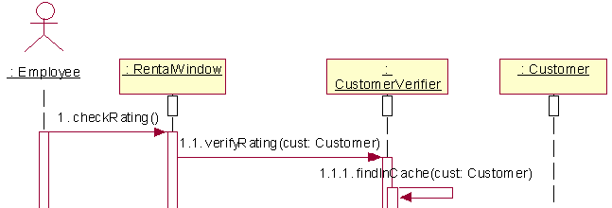
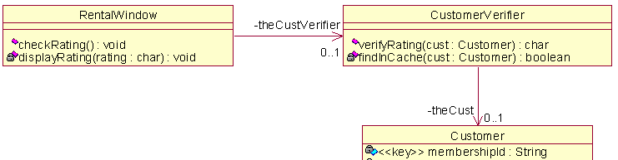
Adding methods to classes

Slide 142
Review Quiz 3.4
Is the modeling element of lifeline present in sequence diagrams or in communication diagrams?
Are the concepts of message and method the same?
Notes:
In sequence diagrams.
No, they are not. Message is a call to a method.

Slide 143
5. The state machine view
specifies dynamic changes in a class
describes various states in which objects of the class can be

Slide 144
State machine modeling
Captures dynamic changes of class states
life history of object’s of the class
These dynamic changes describe typically the behavior of an object across several use cases
State of an object – designated by the current values of the object’s attributes
State machine diagram – a bipartite graph of
states (rounded rectangles)
transitions (arrows) caused by events
State machine diagram may model business rules

Slide 145
States and events
Unpaid
partial payment
Partly Paid
final payment
final payment
Fully Paid

Slide 146
State machine diagram
Normally attached to a class, but can be attached to other modeling concepts, e.g. a use case
When attached to a class, the diagram determines how objects of that class react to events
Determines – for each object state – what action the object will perform when it receives an event
The same object may perform a different action for the same event depending on the object’s state
The action’s execution will typically cause a state change
The complete description of a transition consists of three parts
event (parameters) [guard] / action

Slide 147
Statechart diagram – excerpt

Slide 148
Review Quiz 3.5
Can the state of an object depend on that object’s association links?
How is a guard different from an event?
Notes:
Yes, it can. Any attribute can influence the state of an object, including attributes that designate other classes (i.e. associations).
The guard condition is evaluated at the point of handling the event to determine if a transition will fire.

Slide 149
The implementation view
architectural/structural modeling of the physical implementation of a system
provides a connection between the logical and physical structure of the system

Slide 150
Implementation models
Component – modular, deployable, and replaceable part of a system that encapsulates implementation and exposes a set of interfaces
→ component diagram
Node – physical object that represents a processing resource, generally, having at least a memory and often processing capability as well
includes computing devices but also human resources or mechanical processing resources
→ deployment diagram

Slide 151
Subsystems and packages
“divida et impera” (divide-and-conquer)
Subsystem
encapsulates some part of system behavior
its services are the result of the services provided by its classes
its services are defined using interfaces
Package
grouping of modeling elements
like subsystem, its services are the result of the services provided by its classes
unlike subsystem, its services are not exposed using interfaces
“The difference between a subsystem and a package is that, for a package, a client asks some element inside the package to fulfill a behavior; for a subsystem, a client asks the subsystem itself to fulfill the behavior.” from Ferm (2003, p.2)

Slide 152
Subsystems and packages
subsystem
package
package

Slide 153
Component diagram
required
interface
provided
interface

Slide 154
Deployment diagram

Slide 155
Review Quiz 3.6
Is subsystem modeled as a stereotype of package or stereotype of component?
Give some examples of artifacts that can be deployed on a node.
Notes:
In UML 2.0, subsystem is modeled as a stereotype of component. However, in earlier versions of UML it was modeled as a stereotype of package.
Model files, source files, scripts, and binary executable files, a table in a database system, a development deliverable, or a word-processing document, a mail message.

Slide 156
Homework
Create a use case diagram for GEMS.
focus on primary actors and main use cases
Write a use case description for one use case you have identified.
use the template described in this lecture
Bring your diagram and use case description to tomorrow’s lecture.
hand drawn diagram is acceptable
© Richard Thomas, 1992–2018

Slide 157
Summary
Use case model is the main UML representation and the focal point of behavior modeling
Activity model can graphically represent the flow of events of a use case
Class modeling integrates and embodies all other modeling activities
Interaction modeling captures the interactions between objects needed to execute a use case or part of it
State machine model specifies dynamic changes in a class
UML provides component diagrams and deployment diagrams as two tools for architectural/structural modeling of physical implementation of the system

